Slide 1

Physical Security
CIS 360 – Prof. C. R. Johnson
University of Wisconsin – Stevens Point

Slide 2
Physical Security Systems
The original security question – how to keep people you down want in from getting in, and how to keep things you don’t want getting out from getting out.
This simple question has grown increasingly complicated as technology evolves and provides new weaknesses to systems.
At the core of physical security is still the same issue, but now with many more considerations.

Slide 3
Definition
Physical security is the protection of personnel, hardware, programs, networks, and data from physical circumstances and events that could cause serious losses or damage to an enterprise, agency, or institution. This includes protection from fire, theft, vandalism, natural disasters, and terrorism.

Slide 4
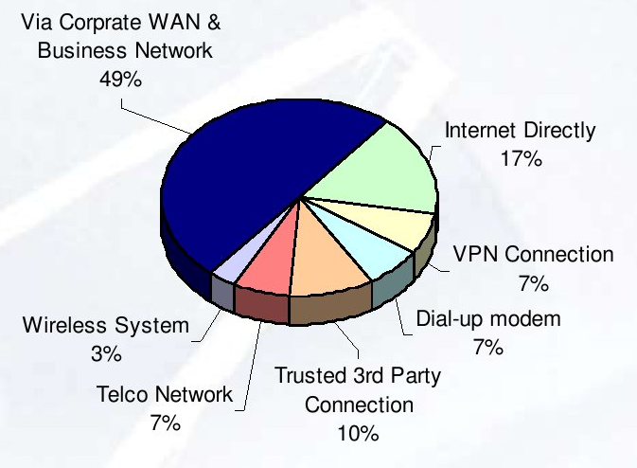
Attack Vectors into Control Systems

Slide 5
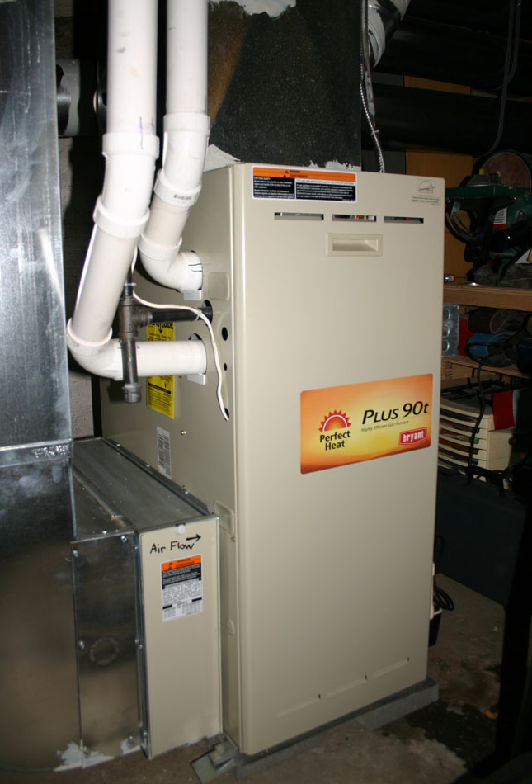
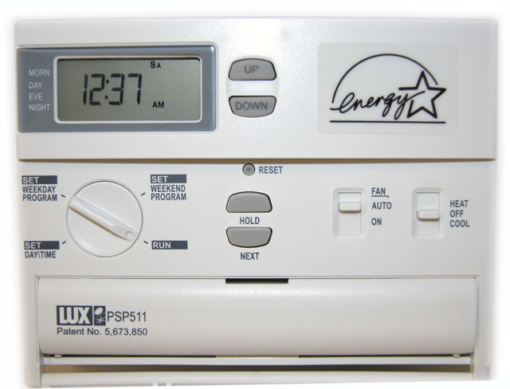

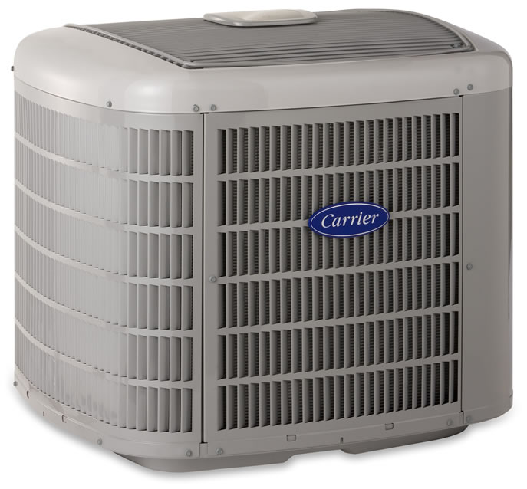
A Control System
Sensor(s) +
Actuator(s) +
Controller(s)

Slide 6
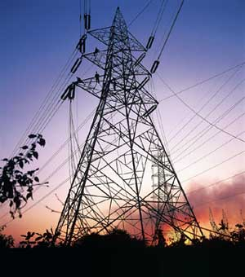
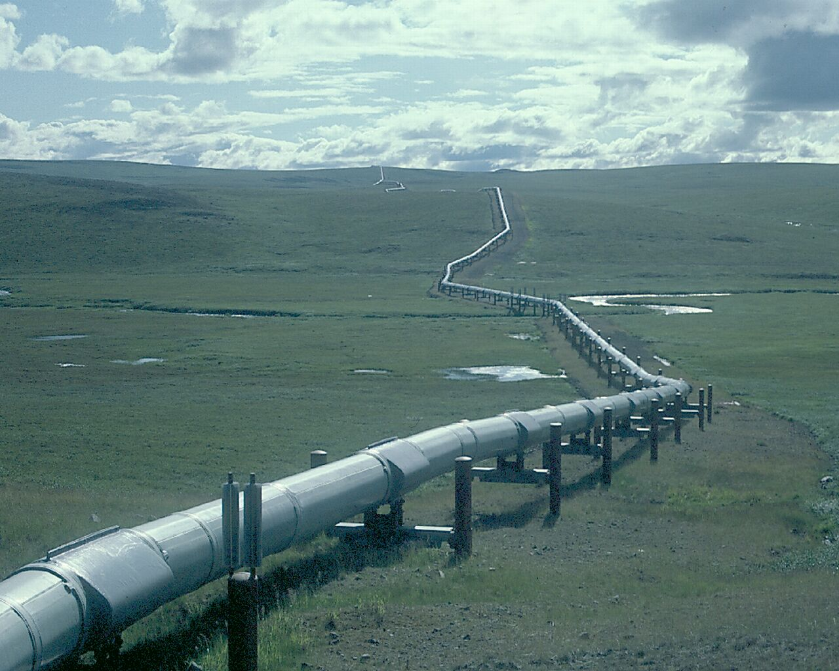
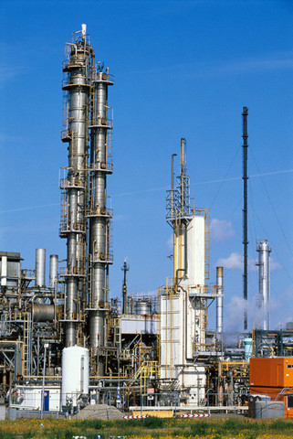
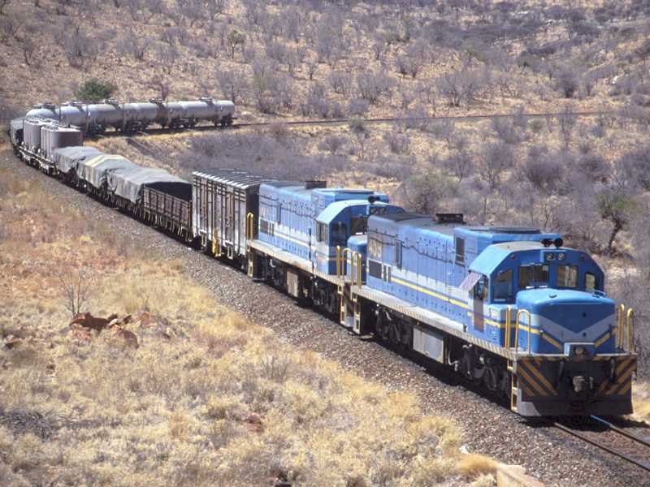
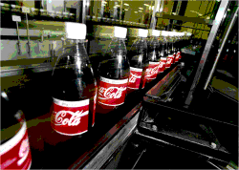

Types of Industrial Control Systems (ICS)
Supervisory Control And Data Acquisition (SCADA)
Process Control Systems (PCS)
Distributed Control Systems (DCS)
Automation
Notes:
Supervisory Control and Data Acquisition (SCADA)
Large distances, supervisory control, non-real-time (minutes)
Used in power (transmission and distribution), gas, oil, water, wastewater, rail, etc.
Process Control Systems (PCS)
Closed loop, central control, near real-time (seconds)
Used in refining, chemical, food, pharmaceutical, etc.
Distributed Control Systems (DCS)
Similar to PCS but multiple controllers physically close to processes
Used in generation, manufacturing, refining, chemical, food, pharmaceutical, etc.
Automation aka Discrete Control
Similar to DCS, real-time (milliseconds)

Slide 7
Historical ICS
Proprietary
Complete vertical solutions
Customized
Specialized communications
Wired, fiber, microwave, dialup, serial, etc.
100s of different protocols
Slow; e.g. 1200 baud
Long service lifetimes: 15–20 years
Not designed with security in mind
Notes:
the slogan “tomorrow’s technology today” of high-tech industries is turned around in the control systems world to “yesterday’s technology tomorrow”.
“security” in power usually means reliability of the grid
there is a big difference between “robust to accidental events” and “robust to intentional engineered attacks”

Slide 8


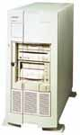

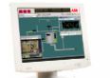
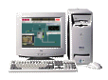

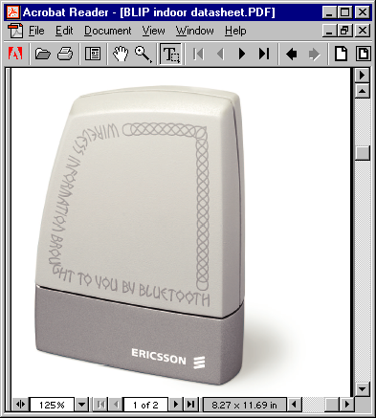
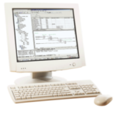
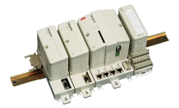
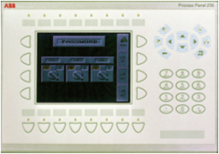
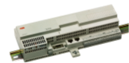


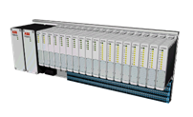
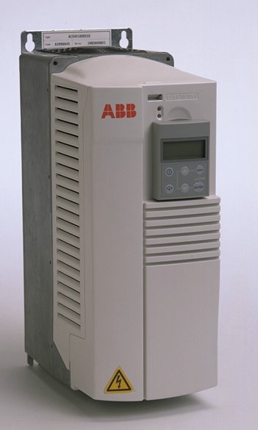
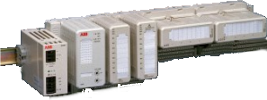




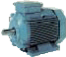
Modern ICS Trends
Internet
Enterprise Network
Enterprise Network
Workplaces
IP
Enterprise
Optimization Suite
Firewall
Third Party Application Server
Mobile Operator
Services
Network
Connectivity
Server
Historian
Server
Application
Server
Engineering
Workplace
Control
Network
Serial, OPC
or Fieldbus
Redundant
Device Network
Third Party
Controllers,
Servers, etc.
Serial
RS485
Notes:
at the bottom, IEDs are usually connected to sensors and controllers by automation networks such as HART, Fieldbus, Profibus, or increasingly by Ethernet
although one process control vendor already offering IPV6 wireless on battery-powered sensors
next level of network consists of ICS master and systems used for operating and managing the ICS
next level of network provides advanced applications, such as optimization and gateways to the enterprise network
Adoption of COTS (Commercial-Off-The-Shelf) technologies
Operating systems—Windows, WinCE, various embedded RTOSes
Applications—Databases, web servers, web browsers, etc.
IT protocols—HTTP, SMTP, FTP, DCOM, XML, SNMP, etc.
COTS software and systems have more capabilities and are cheaper than proprietary systems, and do not leave vendors stranded on out-of-date technology
Connectivity of ICS to enterprise LAN
Improved business visibility, business process efficiency: eg. supply chain management, production scheduling, order tracking, and fault monitoring
(optimize part and supply sourcing, schedule production to better meet business requirements and avoid contract penalties)
Remote access to control center and field devices: eg. remote diagnosis and repair, reduction of personnel at remote sites
Adoption of IP Networking
Common in higher level networks, gaining in lower levels
Many legacy protocols wrapped in TCP or UDP
Most new industrial devices have Ethernet ports
IP penetrating into lower levels of ICS networks due to greater performance, lower cost, more capabilities than proprietary networks
Ease of connectivity to other systems
Greater performance
Lower cost
Interoperability
Future proofing
rate at which these trends are progressing varies between ICS and process control and between control center, communications, and field devices

Slide 9
Technology Trends in ICS
COTS (Commercial-Off-The-Shelf) technologies
Operating systems—Windows, WinCE, embedded RTOSes
Applications—Databases, web servers, web browsers, etc.
IT protocols—HTTP, SMTP, FTP, DCOM, XML, SNMP, etc.
Networking equipment—switches, routers, firewalls, etc.
Connectivity of ICS to enterprise LAN
Improved business visibility, business process efficiency
Remote access to control center and field devices
IP Networking
Common in higher level networks, gaining in lower levels
Many legacy protocols wrapped in TCP or UDP
Most new industrial devices have Ethernet ports
Most new ICS architectures are IP-based
Notes:
trends relevant to networking and security
rate at which these trends are progressing varies between ICS and process control and between control center, communications, and field devices
connectivity improves business efficiency by better supply chain management, just-in-time production, order tracking, fault monitoring, etc. in addition to direct optimization of process itself
IP networking:
Ease of connectivity to other systems
Greater performance
Lower cost
Interoperability
Future proofing

Slide 10
Physical Control security is terrible
Most control systems emphasize stability over all, and often have less development resources.
Remaining on outdated OS
Going unpatched
Requiring network access to work
Have separate user repositories / access controls

Slide 11
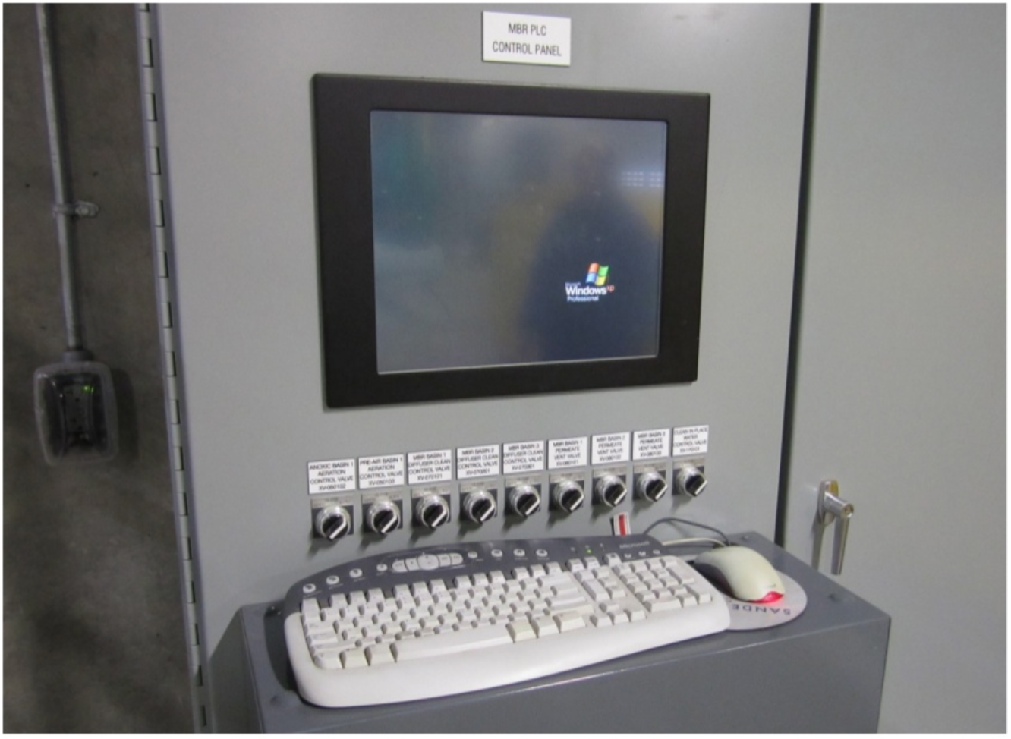

Slide 12
With Physical Access
Firewall rules are bypassed
Hardware can be manipulated
Security can be broken
Physical destruction is possible
Hardware hacking is a thing
Plus theft, increasing the amount of time an attacker has to work.

Slide 13
Layered Security
Physical Barriers
Fences
Alarms
Restricted Access Technology
Physical Restrictions
Air Gapping
Removable Media
Remote Storage
Personnel Security Practices
Limited Access
Training
Consequences/Deterrence

Slide 14
Physical Barriers
Hardened Facilities
Fences
Guards
Alarms
Locks
Restricted Access Technologies
Biometrics
Coded Entry
Badging
Signal Blocking (Faraday Cages)

Slide 15
Outer Protective Layers
Structure
Fencing, gates, other barriers
Environment
Lighting, signs, alarms
Purpose
Define property line and discourage trespassing
Provide distance from threats

Slide 16
Unpatched Systems
Many ICS systems are not patched current
Particularly Windows servers
No patches available for older versions of windows
OS and application patches can break ICS
OS patches are tested for enterprise apps
Uncertified patches can invalidate warranty
Patching often requires system reboot
Before installation of a patch:
Vendor certification—typically one week
Lab testing by operator
Staged deployment on less critical systems first
Avoid interrupting any critical process phases
Notes:
No patches available for windows NT, 98, ME
Windows 2000 supported only until 2010
Cisco and other released a patch for TCP support Sept 2009 (DOS prevention)

Slide 17
Limited use of Host Anti-Virus
AV operations can cause significant system disruption at inopportune times
3am is no better than any other time for a full disk scan on a system that operates 24x7x365
ICS vendors only beginning to support anti-virus
Anti-virus is only as good as the signature set
Signatures may require testing just like patches
AV may be losing ground in enterprise deployments
impact on hosts, endpoint security not getting better
virus writers have learned to test against dominant AV
application whitelisting can be a good alternative
enumerate goodness rather than badness

Slide 18
Poor Authentication and Authorization
Machine-to-machine comms involve no “user”
Many ICS have poor authentication mechanisms and very limited authorization mechanisms
Many protocols use cleartext passwords
Many ICS devices lack crypto support
Sometimes passwords left at vendor default
Device passwords are hard to manage appropriately
Often one password is shared amongst all devices and all users and seldom if ever changed
This is happening AGAIN in Smart Meter deployments!
Notes:
Queensland
extreme example: password limited to 3 uppercase characters

Slide 19
Poor Audit and Logging
Many ICS have poor or non-existent support for logging security-related actions
Attempted or successful intrusions may go unnoticed
Where IDS logs are kept, they are often not reviewed
Various regulatory requirements are driving some change in this area
NERC—North American Electric Reliability Corporation
FERC—Federal Energy Regulatory Commission
Sarbanes Oxley and PCAOB (Public Company Accounting Oversight Board)
FISMA—Federal Information Security Management Act
Notes:
SoX passed in response to scandals like Enron, relates to financial accounting, and the PCAOB auditing standard #2 states “IT Controls should be tested, including controls over relevant assertions related to all significant accounts and disclosures in the financial statements”

Slide 20
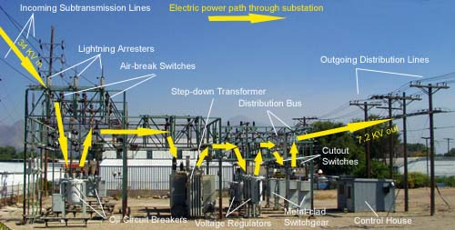
Unmanned Field Sites
Many unmanned field sites
Many with dialup access
Some with high-speed connectivity to control center
Most with poor authentication and authorization
backdoor to the control center!

Slide 21
Middle Protective Layers
Structure
Door controls, window controls
Ceiling penetration
Ventilation ducts
Elevator Penthouses
Environment
Within defined perimeter, positive controls
Purpose
Alert threat, segment protection zones

Slide 22
Inner Protective Layers
Several layers
Structure
Door controls, biometrics
Signs, alarms, cctv
Safes, vaults
Environment
Authorized personnel only
Purpose
Establish controlled areas and rooms

Slide 23
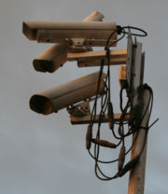
Components
Accidental and environmental disasters
Placing obstacles
Idea is to confuse attacker, delay serious ones, and attempt to avoid the inevitable
Monitoring and notification systems
Security mechanisms to monitor and detect potential harm or violations
Alarms, security lighting, security guards or closed-circuit television cameras (CCTV)

Slide 24
Components (cont.)
Recovery mechanisms
To repel, catch or frustrate attackers when an attack is detected
Intrusion handling

Slide 25
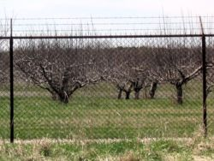
Layers
Environment Design
First layer of physical protection
Consists of external design void off intruders
May include objects like barbed wire, warning signs, fencing, metal barriers, and site lighting

Slide 26
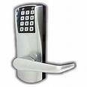
Layers (cont.)
Mechanical and electronic access control
Prevents intruders or unauthorized users to direct access to physical components
Includes gates, doors and locks

Slide 27
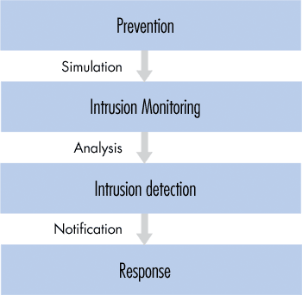
Layers (cont.)

Slide 28
Implementation
State the plan’s purpose
Define the areas, buildings, and other structures considered critical and establish priorities for their protection
Define and establish restrictions on access and movement of critical areas
Categorize restrictions

Slide 29

Layers (cont.)
Monitoring system
Less of a preventative measure
Used more for incident verification and analysis
Most common mechanism is CCTVs

Slide 30
Layers (cont.)
Intrusion Detection
Monitors for attacks
Less of a preventative measure
More of an response mechanism
Alarms/Notification

Slide 31
Physical Security Briefs
Security site brief
Security policies used for the framework of preventing the access to a physical setting
Security design brief
Security policies used for the layout or design for a physical entity (may be coding, layout for servers, access control, etc)

Slide 32
Zoning
Public Zone
Public has access to this area of a facility and its surrounding
Examples are facility grounds, elevator lobbies, etc
Reception Zone
Zone which entail the transition from a public zone to a restricted-access area of control
Typically means where the contact of visitors and a department is initiated

Slide 33
Zones (cont.)
Operations Zone
An area where access is limited to personnel who work at facility and to escorted visitors
Production floors and open office areas
Security Zone
An area to which access is limited to authorized personnel and to authorized and escorted visitors
Area where secret information is processed/stored

Slide 34
Layers (cont.)
High Security Zone
An area where access is limited to authorized, appropriately screened personnel and authorized and properly escorted visitors
A general example would be an area where high-value assets are handled by selected personnel

Slide 35
Trust Me, I’m a doctor
Security often begins by developing a concept of trust that is within the risk appetite of the organization, then developing security measures based upon what are call Trust Zones.
You’re likely familiar with this concept in browsers, but it’s used everywhere.
Basically, less trust is required to access non-sensitive data. Maybe only a password. If the user wants access to a higher-level (more restricted) trust zone, they must identify themselves again. This could be the same factor as before, or with a second factor.
Some organizations have a culture of not automatically providing users access to areas/systems within common trust zones – these are called Zero-Trust Environments, and provide the best security at the expense of convenience.

Slide 36
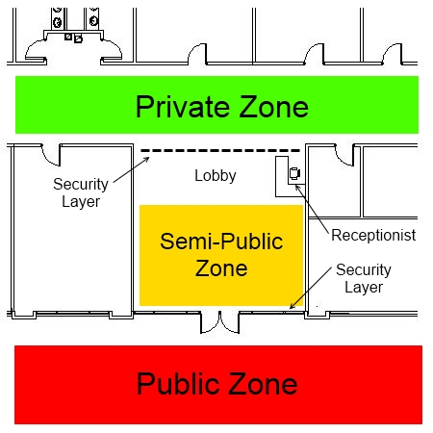
Zone restrictions require security
A security layer has to be established between zones in order to establish boundaries of the zone. Walls do most of this, but there must be ingress/egress.
A boundary is established by deterrents, like perimeter markers, security lights, warning signs, etc.

Slide 37
Zone restrictions require security
A security layer is some manner of obstacle to prevent a subject from moving from one zone or another without being challenged.
This could be a guard, but there are plenty of other options –locks, for example.
You can also maximize the efficiency of human resources by monitoring security layers to ensure they aren’t tampered with or intruded upon.
A place without monitoring is a blind spot.

Slide 38
Zone restrictions require security
Sometimes a zone is established between zones that establishes a buffer between zones – this is a DMZ.
As best practice, the most secure zone is contained in within increasingly restricted zones. This is called Depth of Security. A DMZ is absolutely necessary when this isn’t possible and a high security zone borders lower-tier zones.

Slide 39
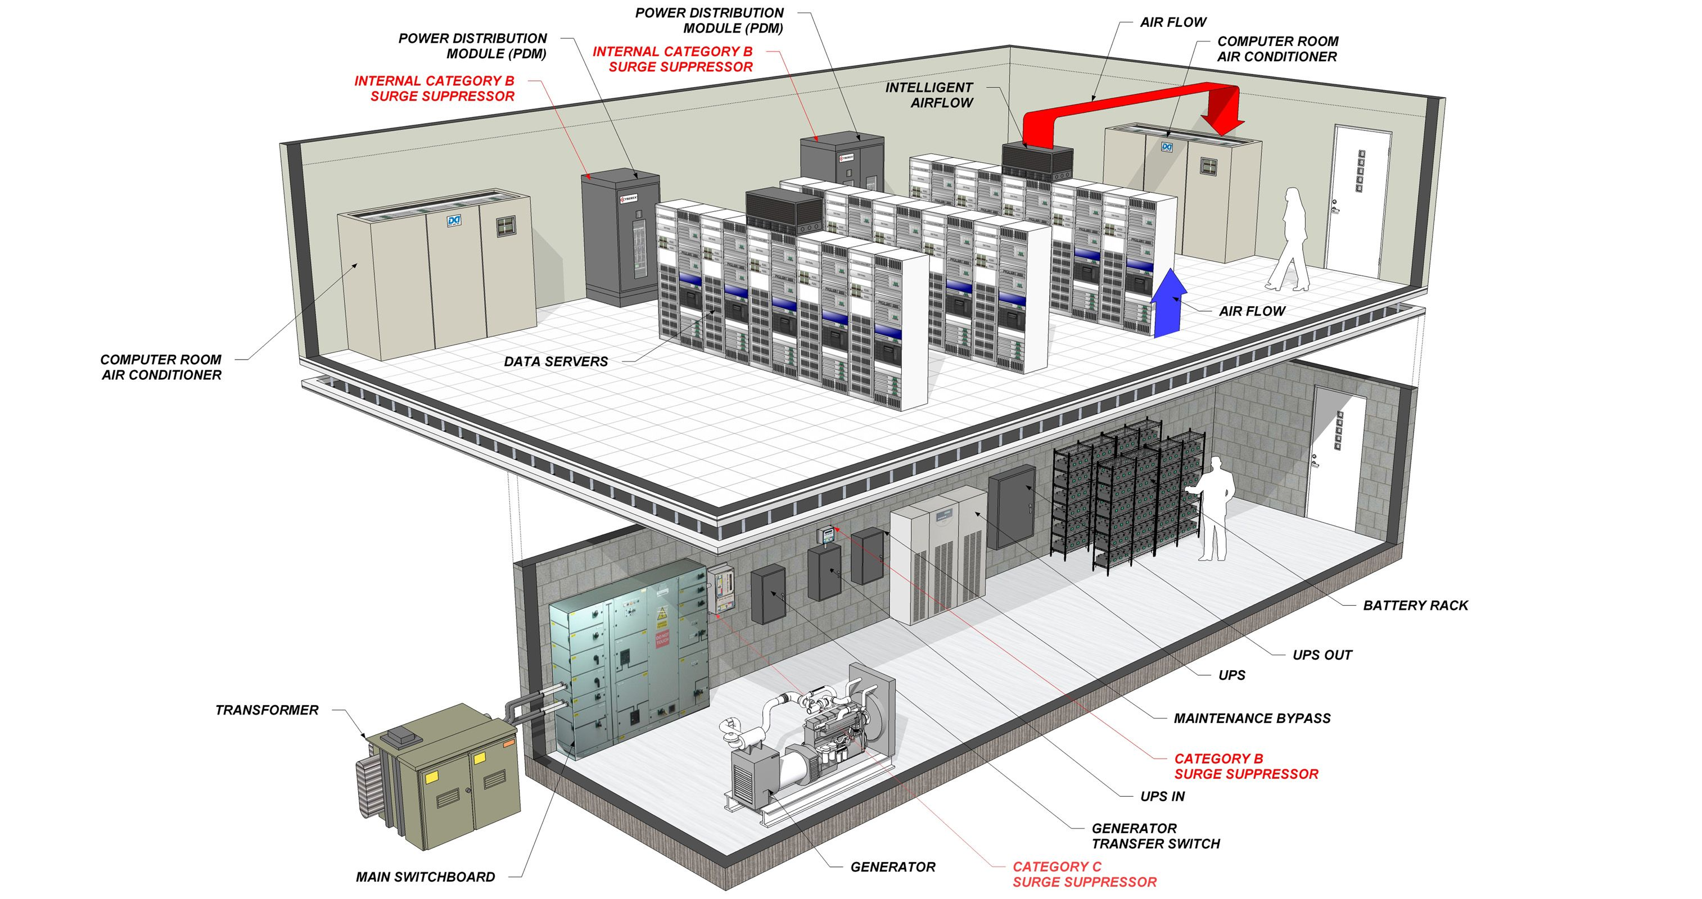

Slide 40
Passing Security Challenges
Identity Proofing – Ensuring credentials are issued only to authorized individuals.
User Recertification – Periodically ensuring user entitlements are appropriate and required.
Entitlement Review – Ensuring all requests for new access are examined and approved.

Slide 41
Other Barrier Issues
Handling of trash or scrap
Fire:
Temperature
Smoke
Pollution:
CO
Radon
Flood
Earthquake

Slide 42
Physical Restrictions
Air Gapping Data
Limits access to various security levels
Requires conscious effort to violate
Protects against inadvertent transmission
Removable Media
Removable Hard Drives
Floppy Disks/CDs/ZIP Disks
Remote Storage of Data
Physically separate storage facility
Use of Storage Media or Stand Alone computers
Updating of Stored Data and regular inventory

Slide 43
Personnel Security Practices
Insider Threat the most serious
Disgruntled employee
Former employee
Agent for hire
Personnel Training
Critical Element
Most often overlooked
Background checks
Critical when access to information required
Must be updated
CIA/FBI embarrassed

Slide 44
People
Disgruntled employee / former employee
Moonlighter
Marketing, sales representatives, etc.
Purchasing agents, buyers, subcontract administrators
Consultants
Vendor/Subcontractor
Clerical
Applicants, Visitors, Customers

Slide 45
Activities or Events
Publications, public releases, etc.
Seminars, conventions or trade shows
Survey or questionnaire
Plant tours, “open house”, family visits
Governmental actions: certification, investigation
Construction and Repair

Slide 46
Technical Security
Alarms
Loud and Noisy
Silent
Integrated into barrier methods
Video/Audio
Deterrent factor
Difficult to archive
Bio-Metrics
Identification
Reliability questions

Slide 47

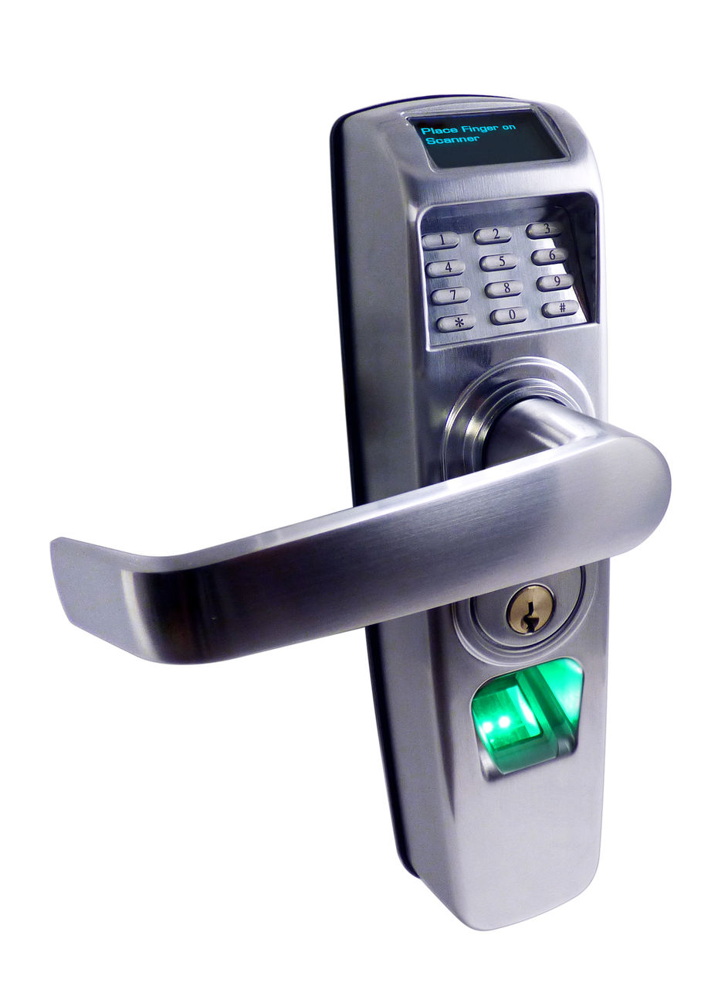
Authentication
Mutli-Factor Authentication –
Something you know
Something you have
Something you are
Co-Initiate System Factors –
Temporal
Geographic

Slide 48
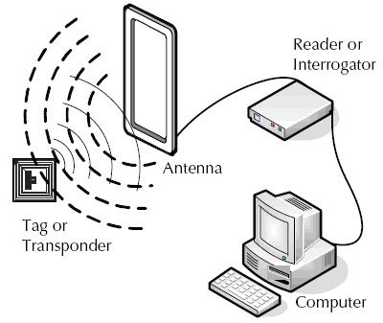
RFID Tech

Slide 49
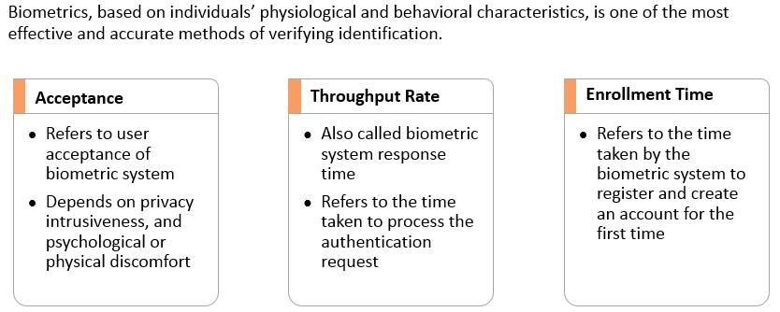
Biometrics – Characteristics
Notes:
Section breaker slide with customer logo
Section heading – Arial Headings, 34, Bold
Sub head – Arial Headings, 18, normal
Used for a section heading. You may add a sub heading not exceeding one line also here
Section heading – Arial Headings, bold, 34 font size, should not exceed beyond 1 line
Sub Head – Arial Headings, normal, 18 font size, should not exceed beyond 1 line

Slide 50
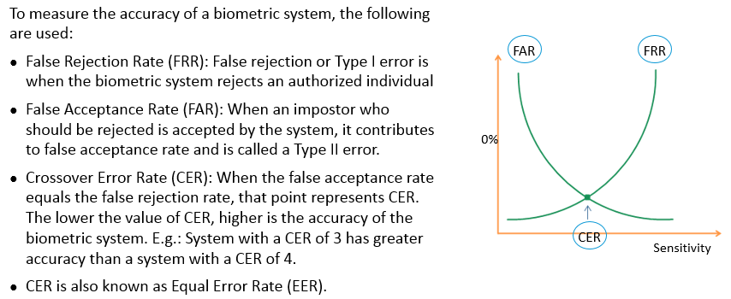
FRR, FAR and CER
Notes:
Section breaker slide with customer logo
Section heading – Arial Headings, 34, Bold
Sub head – Arial Headings, 18, normal
Used for a section heading. You may add a sub heading not exceeding one line also here
Section heading – Arial Headings, bold, 34 font size, should not exceed beyond 1 line
Sub Head – Arial Headings, normal, 18 font size, should not exceed beyond 1 line

Slide 51
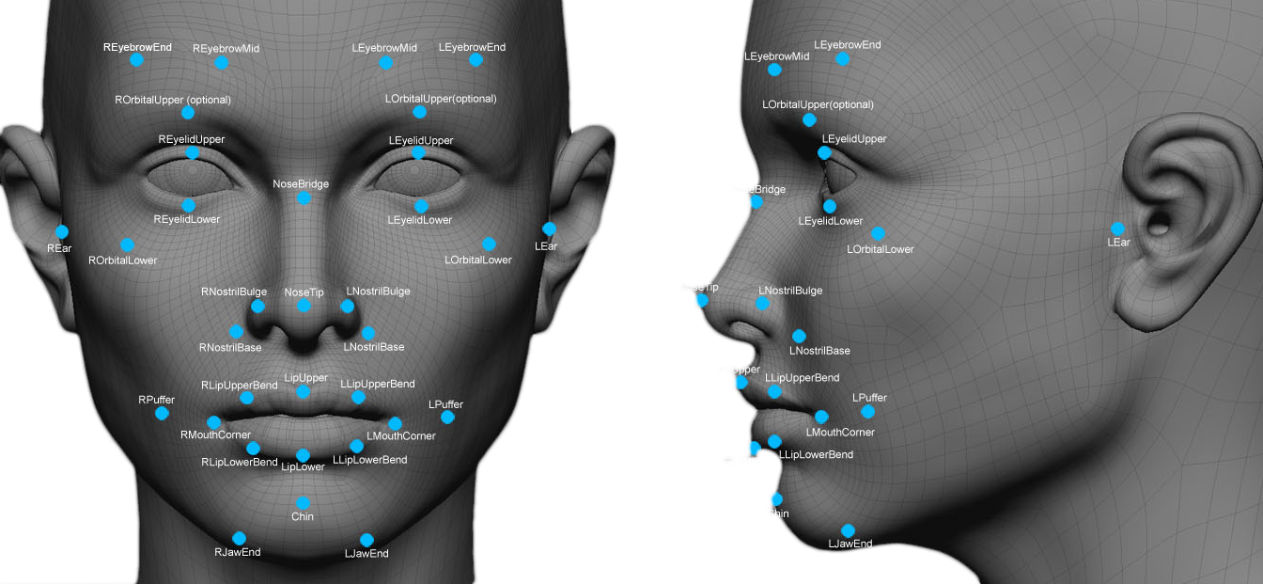

Slide 52
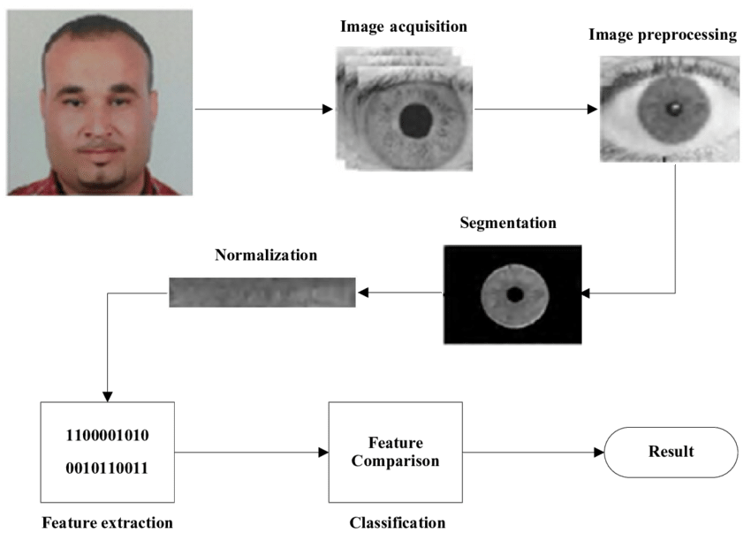

Slide 53
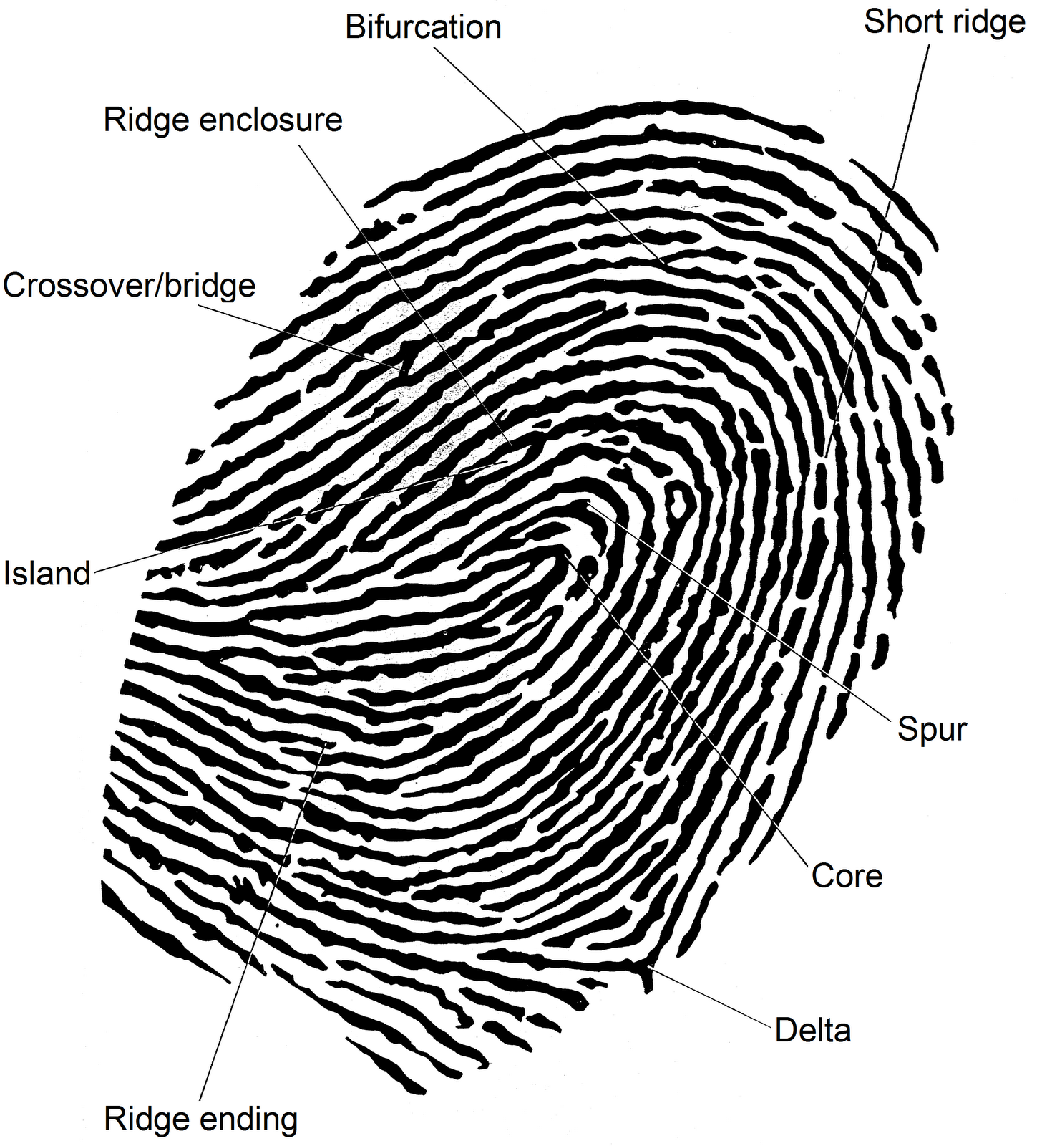
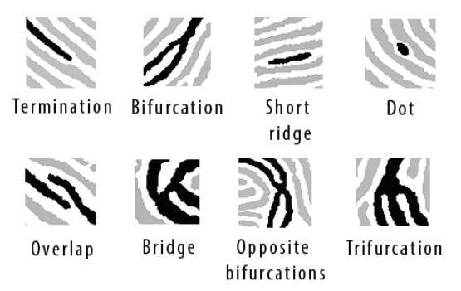
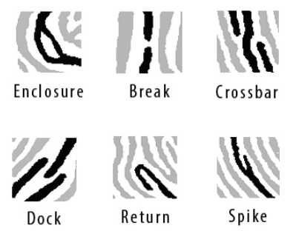

Slide 54
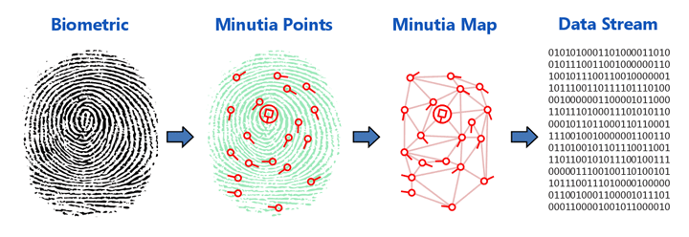

Slide 55
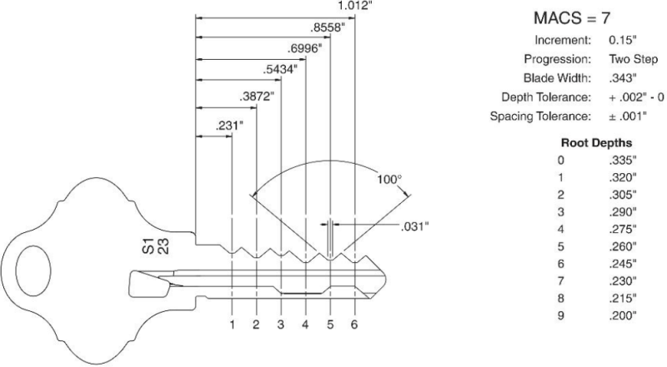
Key Bitting

Slide 56
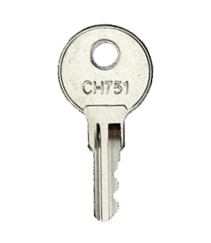

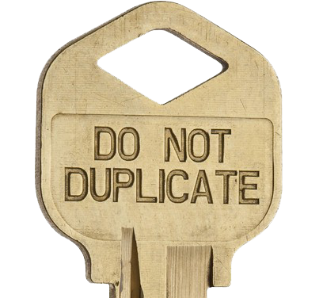
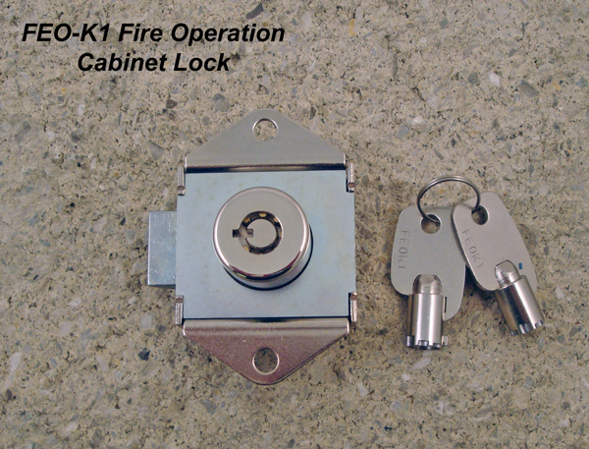
If you see your principle using these keys…
C415A
C420A
C642A
1284X
2642
6642
1620
3910
CC1
FEO-K1
A126 linear
CH751
501CH
C346A
C390A
C413A
CC1

